Slide 1
Mobile Robotics
Lecture 01: Introduction
Sai Shubodh P & K Madhava Krishna
Aug 11, 2020

Slide 2
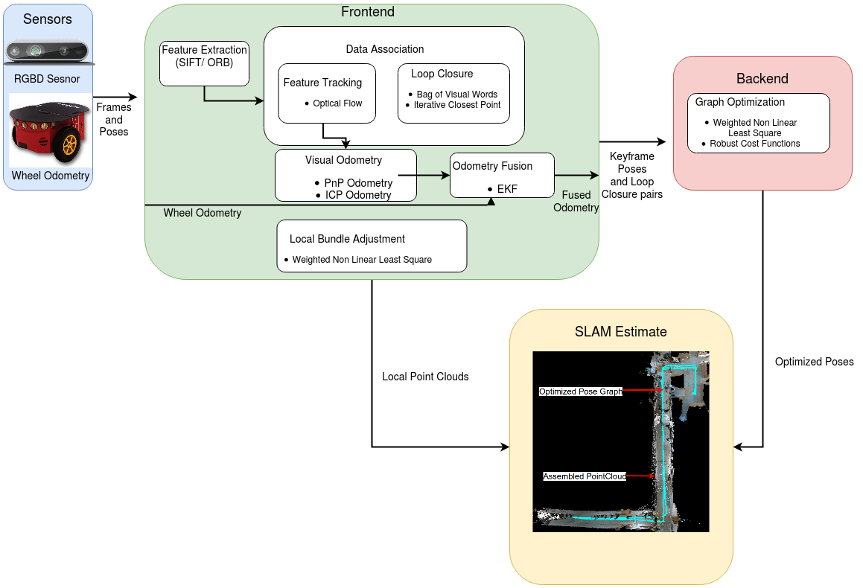
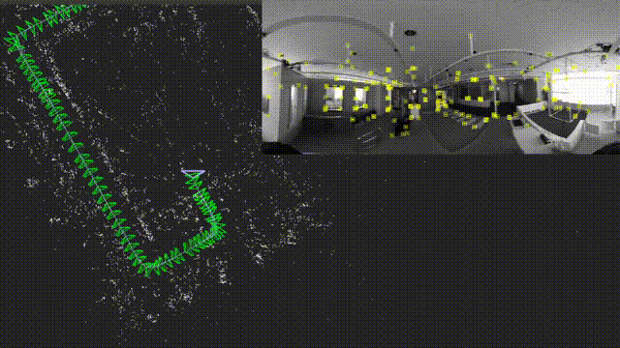
Course
Overview

Slide 3
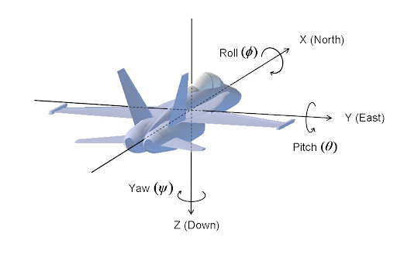
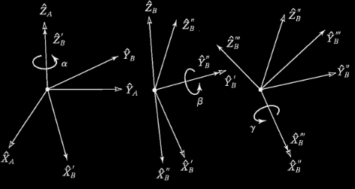
Module I: Basics of SLAM
Transformations
Roll-pitch-yaw
Euler Angles Representation

Slide 4
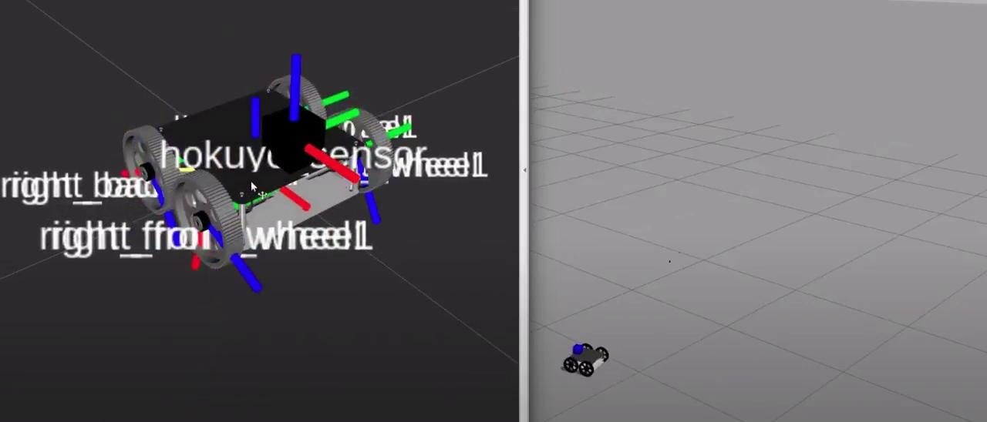

Module I: Basics of SLAM
Transformations (contd..)

Slide 5
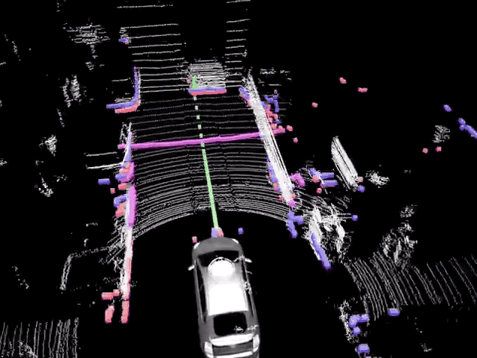
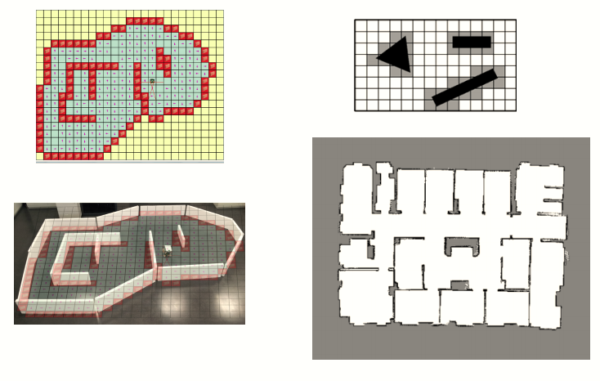
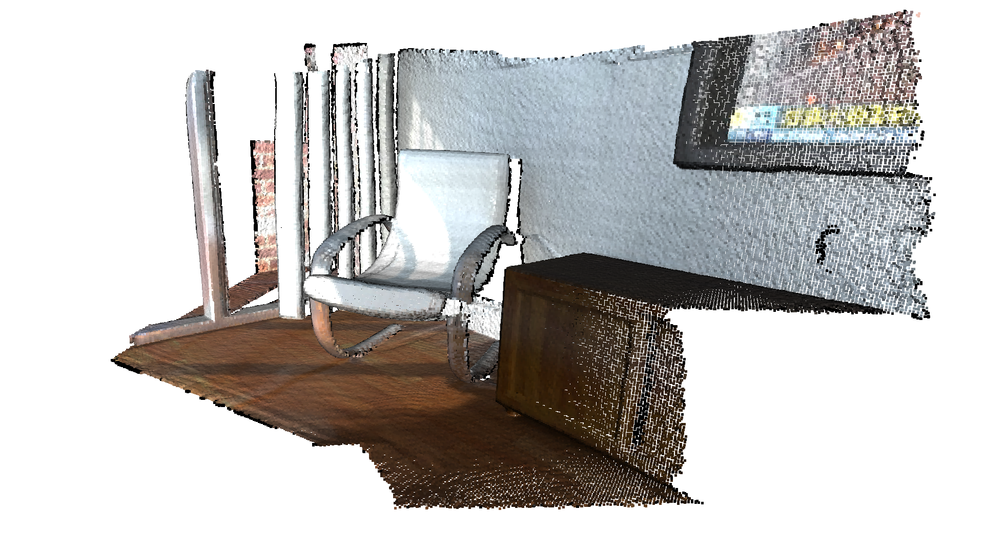
Module I: Basics of SLAM
Mapping
Point clouds (Planar and 3D), point clouds in global frame, Occupancy Maps, Octomaps, Costmaps, Signed Distance Functions (SDF).
Point Clouds
Occupancy Grid Maps
LiDAR maps on a self driving car

Slide 6
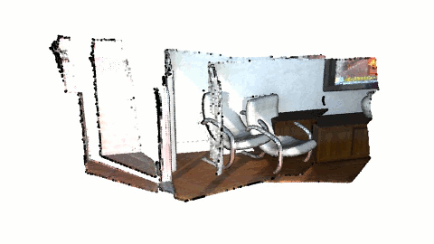
Module I: Basics of SLAM
Point Cloud Registration
Iterative Closest Point Algorithm

Slide 7
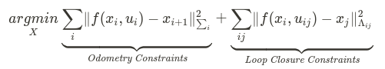
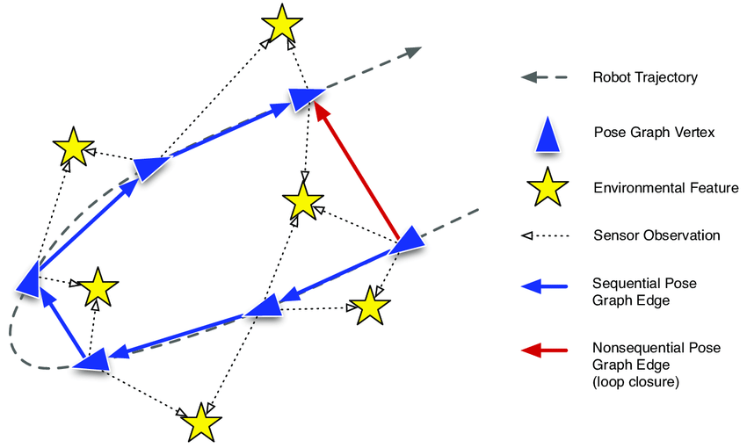
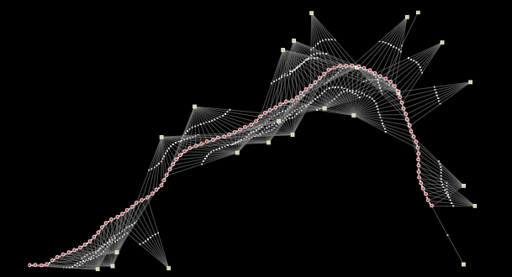
Module II: SLAM Backend & Sensor Fusion
SLAM as Least Squares & Pose Graph Optimization
The Least Squares Formulation:
Anatomy of a Pose Graph
Pose Graphs in a practical setting

Slide 8
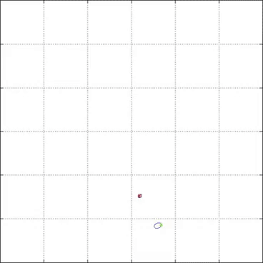
Module II: SLAM Backend & Sensor Fusion
Kalman Filtering
Red dots: Poses of robot
Green dots: Landmarks
Circles: Uncertainty

Slide 9
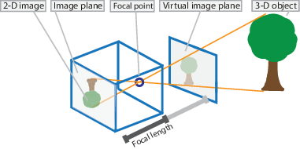
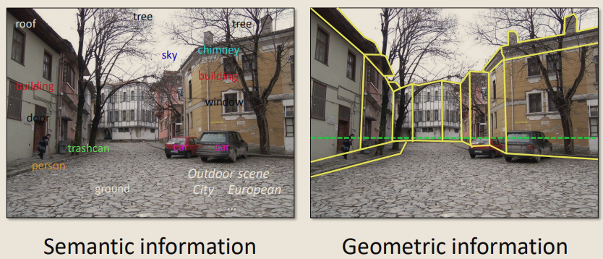
Module III: SLAM Frontend - Computer Vision
Single view Geometry & Camera modelling
Pinhole camera model
Semantic Information
Geometric Information
In this course, we'll learn how to extract Geometric Information through camera modelling and multi view geometry.

Slide 10
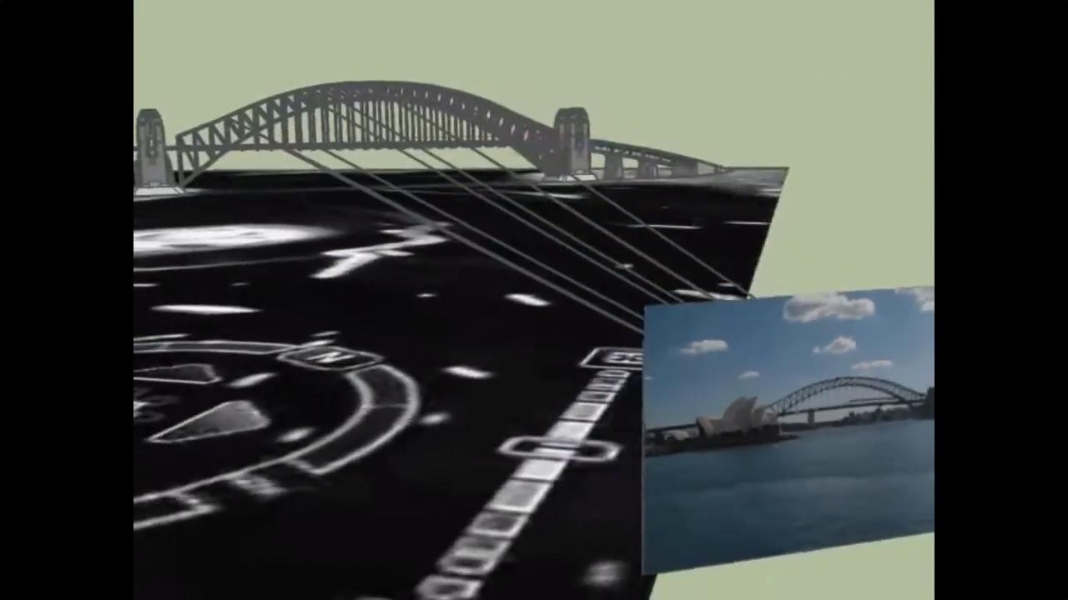
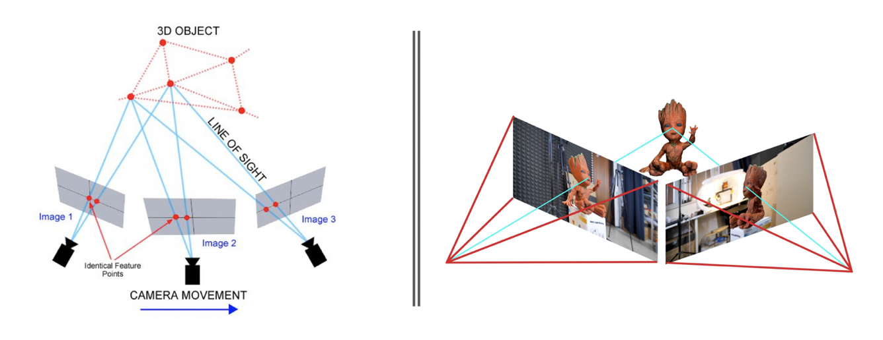
Module III: SLAM Frontend - Computer Vision
Multi-view geometry
Multi-view Geometry
2-view Geometry

Slide 11
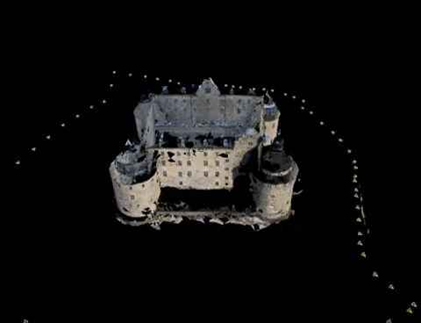
Module III: SLAM Frontend - Computer Vision
Multi-view geometry: Structure from Motion

Slide 12
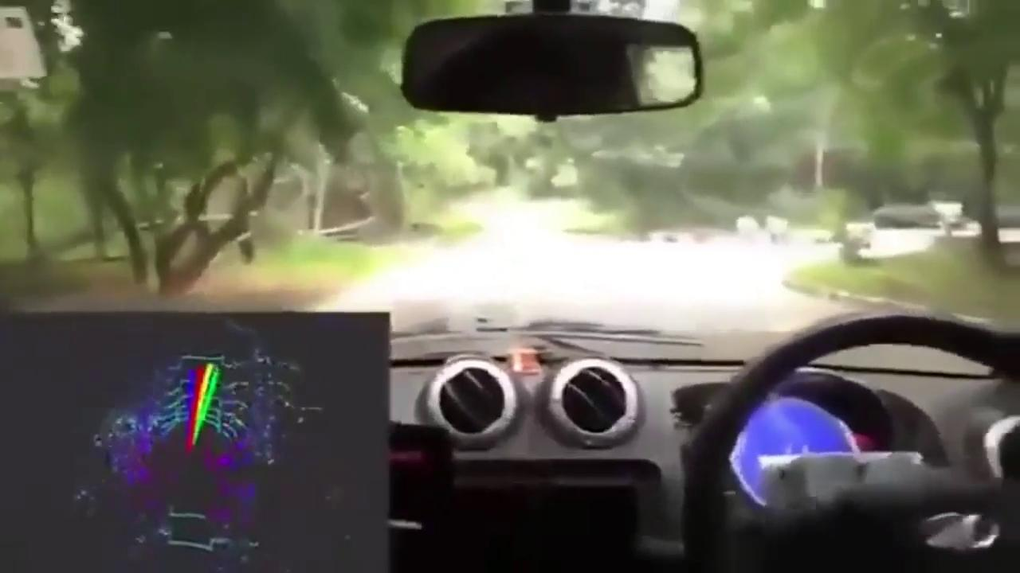
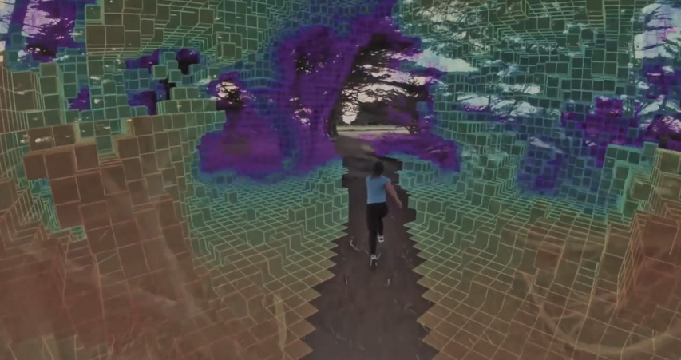
Applications
RRC Self Driving Car demo
Drones

Slide 13
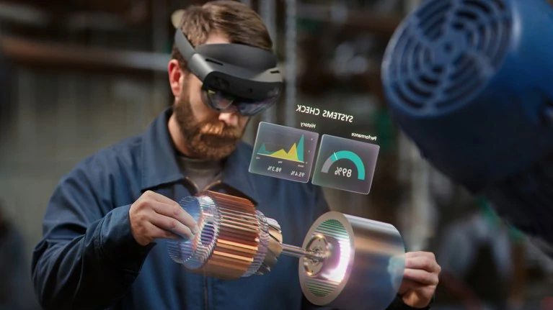
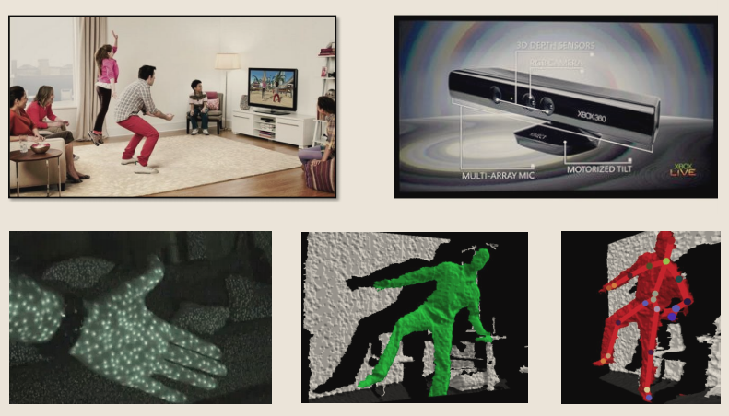
Applications
AR/VR
Gaming
Microsoft Hololens
Xbox Kinect

Slide 14
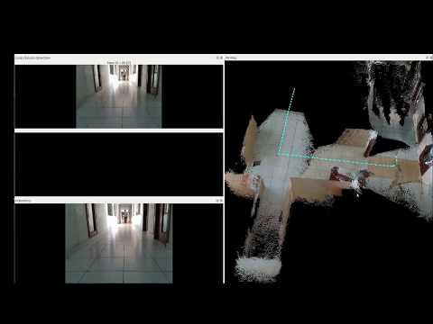
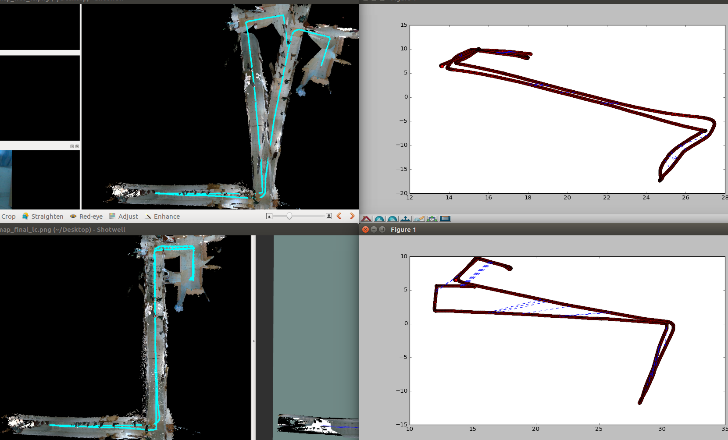
Some cool RRC Lab SLAM Demos
RTABMAP SLAM on Lab Dataset
RGBD camera and Wheel Odometry are used as sensor inputs for mapping.
Loop closure constraints, along with robot poses and map using RTABMAP SLAM.

Slide 15
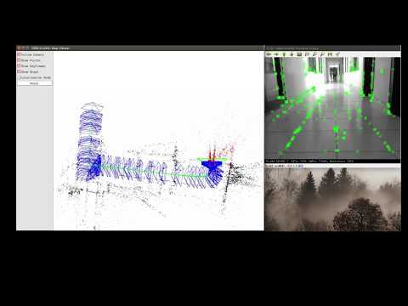
Some cool RRC Lab SLAM Demos
ORB SLAM on Lab Dataset
A monocular RGB camera is used as a sensor input for Mapping.

Slide 16
